Slide 1
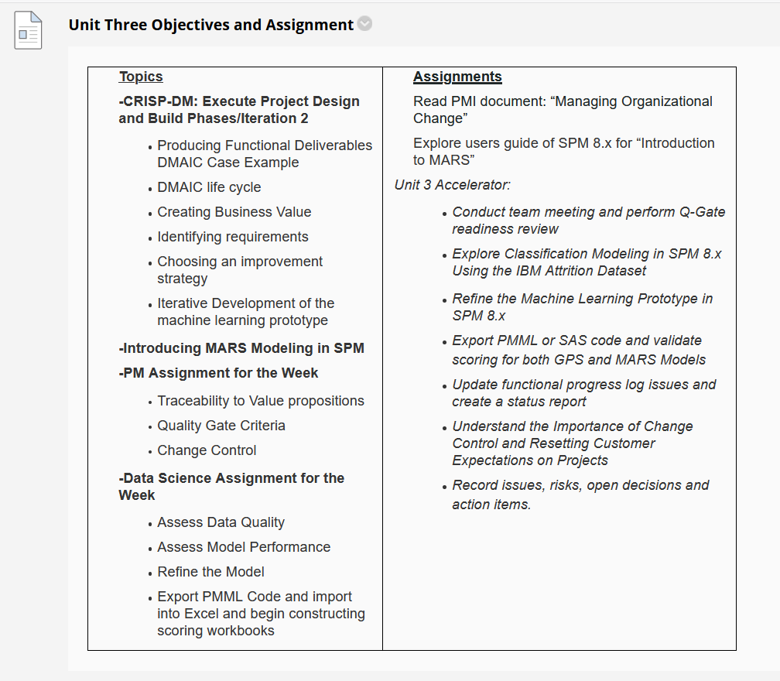

Slide 2
Observations on Homework
Overall solid effort across all teams, good progress for your first iteration model. Lots of innovative ideas and collaboration. Example of Wisconsin progress in Appendix and in data file on this week’s Blackboard
For this week stay focused on enhancing the explanatory and predictive power of the model for iteration #2. Your next assignment will not be due until July 6th.
Keep in mind that two separate forms of value-added policy guidance can emerge:
Identification of factors that “influence” deaths or cases (deductive testing of Beta coefficients)
Machine Learning regression models that provide “predictions” (prediction error from test sample)
This week you will want to corroborate your findings with your program team and across program teams.
This week you will want to develop a list of policy implications and list the key elements of a county response plan for the future that: 1) minimizes risks of residents and 2) keeps businesses open in the local economy.
Hypothesis testing of association between two variables can be done using correlation coefficients. See next slides.

Slide 3
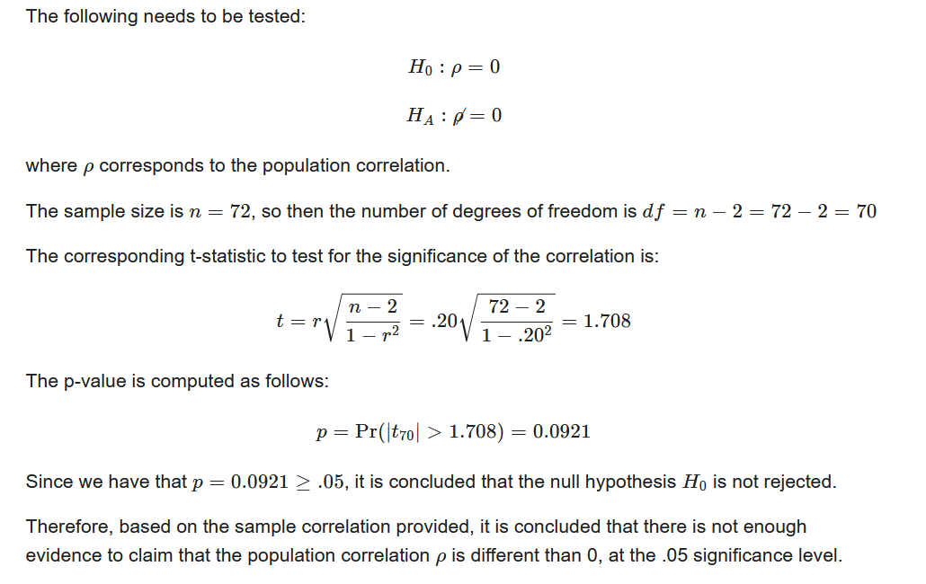
Wisconsin Has 72 Counties. What If a Correlation of 0.20 Between Two Variables at .05 Level of Significance?
https://blog.minitab.com/blog/adventures-in-statistics-2/understanding-t-tests-t-values-and-t-distributions

Slide 4
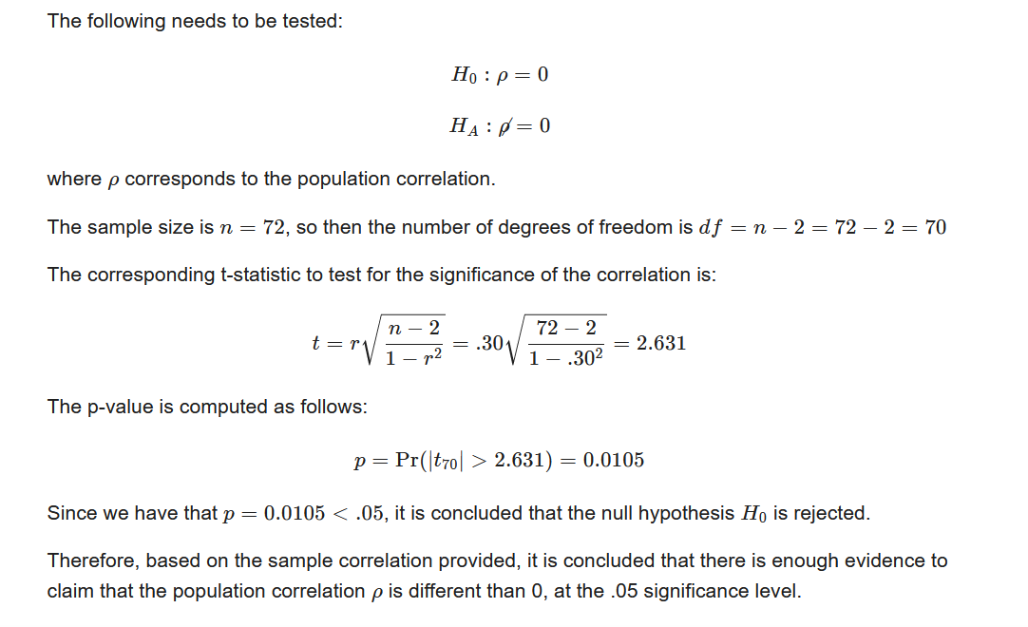
Wisconsin Has 72 Counties. What If a Correlation of 0.30 Between Two Variables at .05 Level of Significance?

Slide 5
Next We Consider A Business Scenario Using Classification With the IBM Attrition Dataset

Slide 6
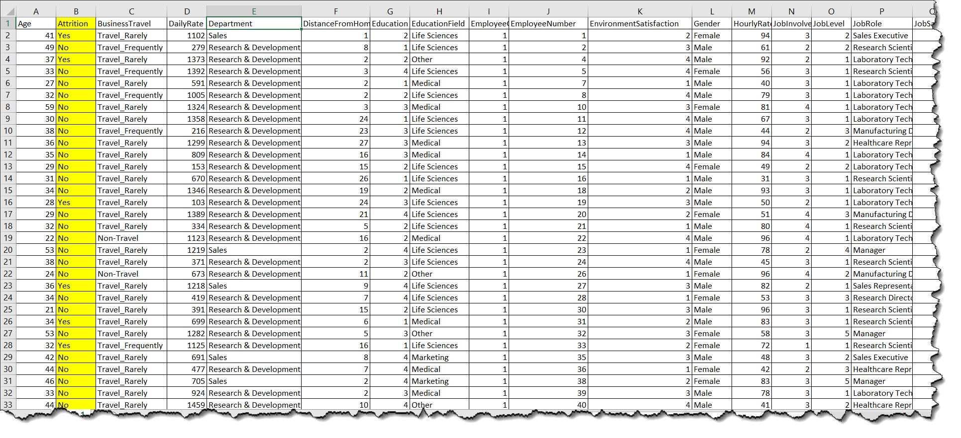
Our Sample HCM Data Set: IBM Attrition Dataset—Each Record Ref an Employee
n=1470

Slide 7
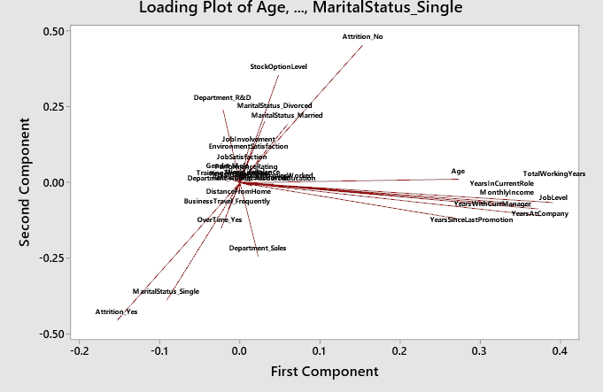
Unsupervised Learning

Slide 8
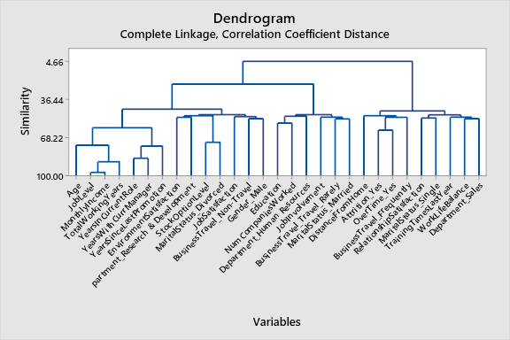

Slide 9
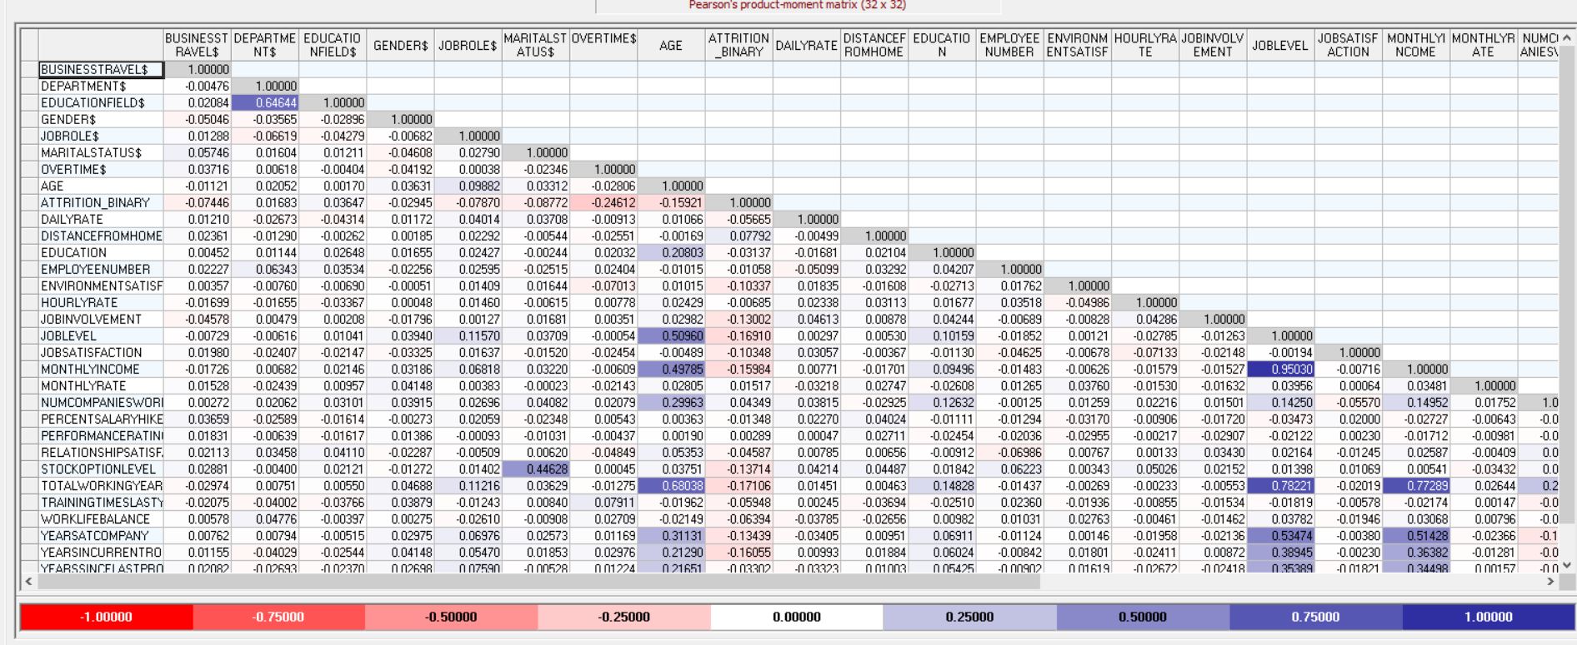

Slide 10
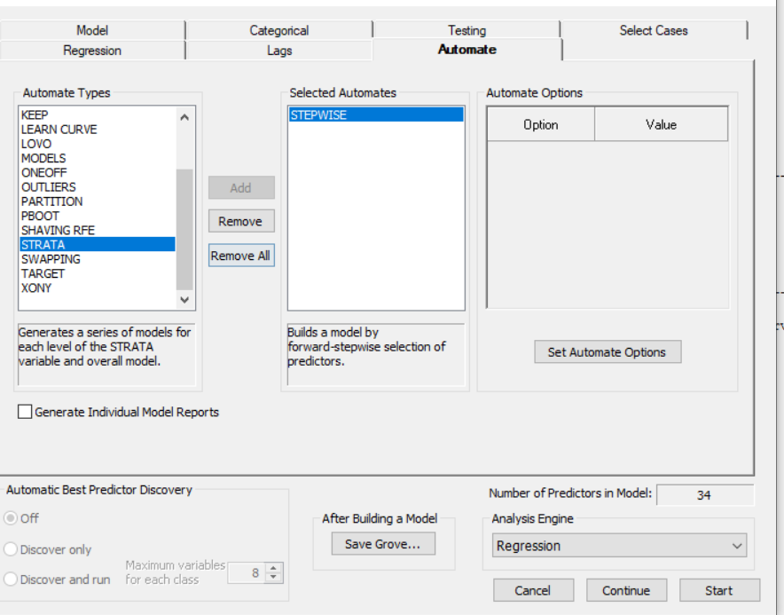

Slide 11
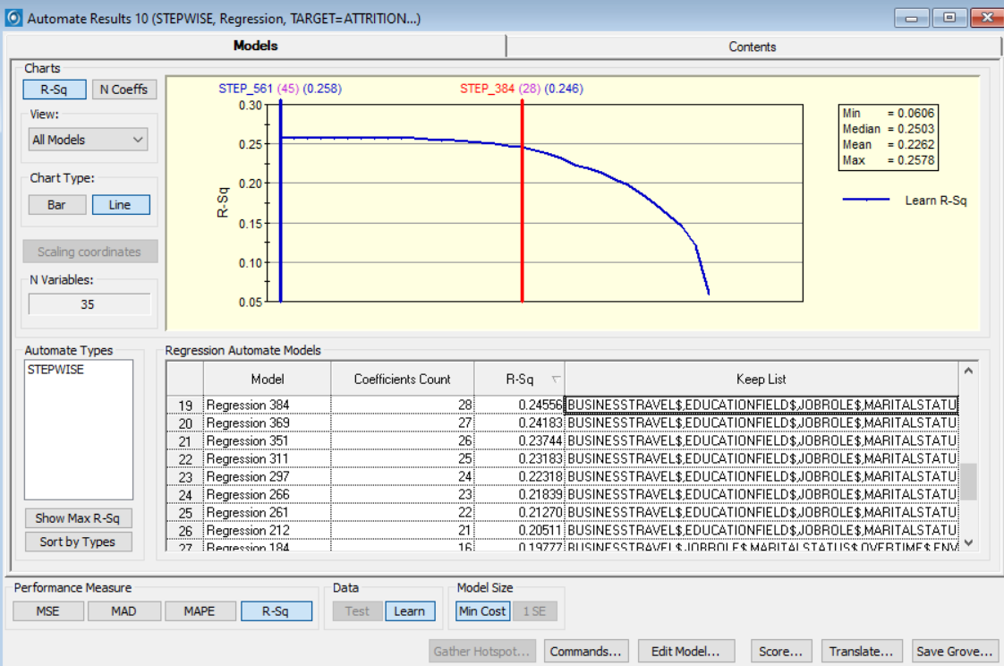

Slide 12
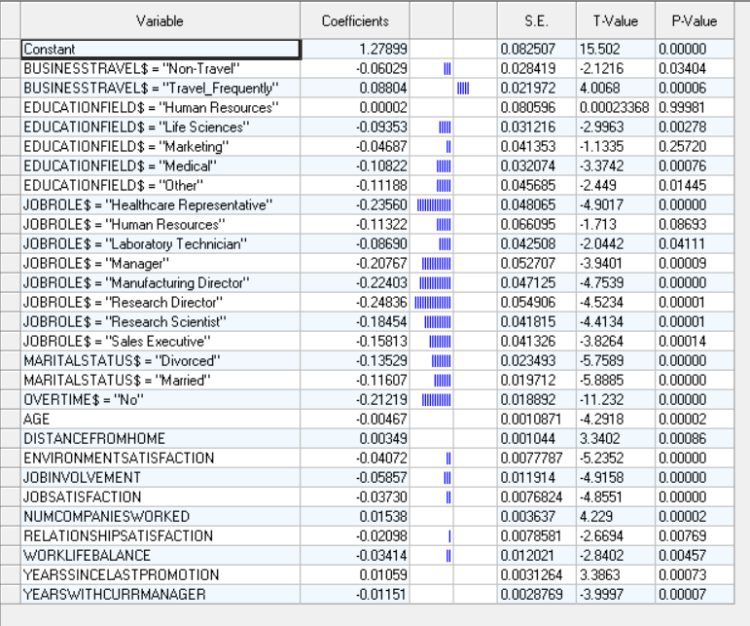

Slide 13
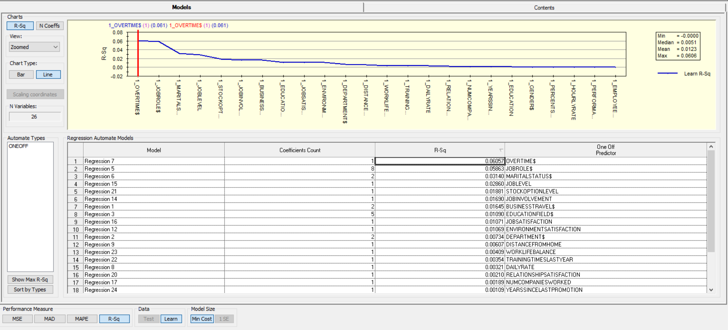
Converted Attrition Category to Binary Numeric

Slide 14
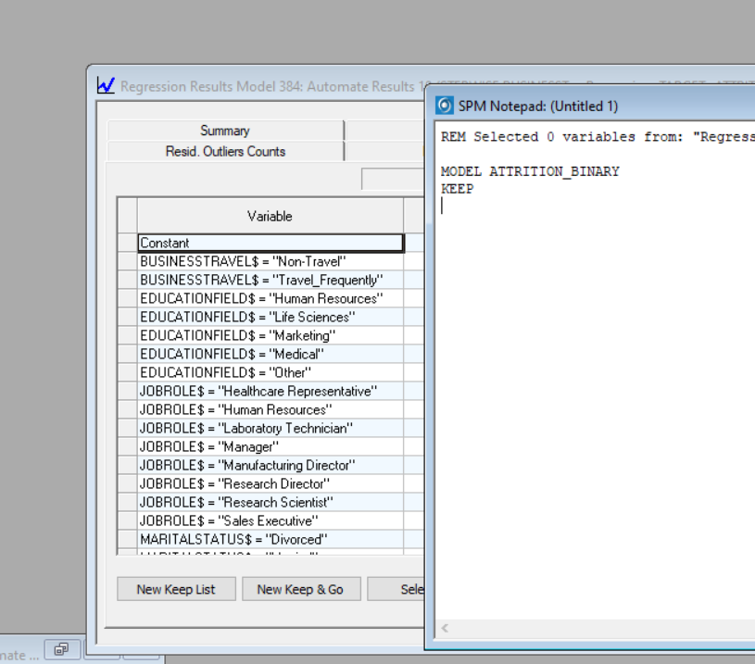

Slide 15
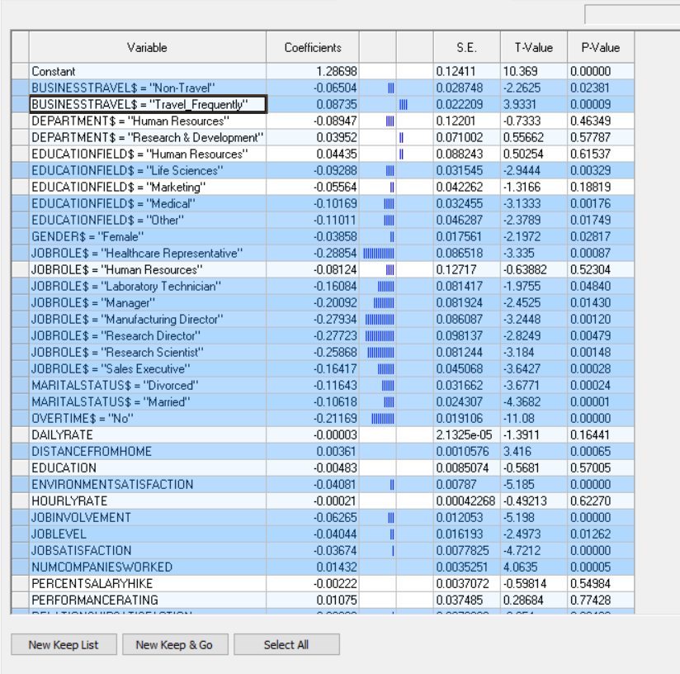
As an option:
New Keep List
Mark by Control and Left Click

Slide 16
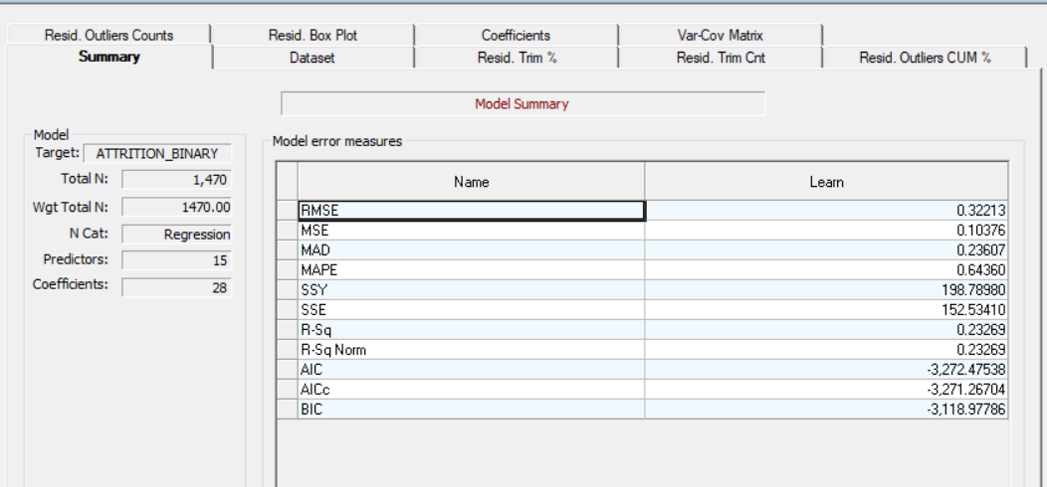

Slide 17
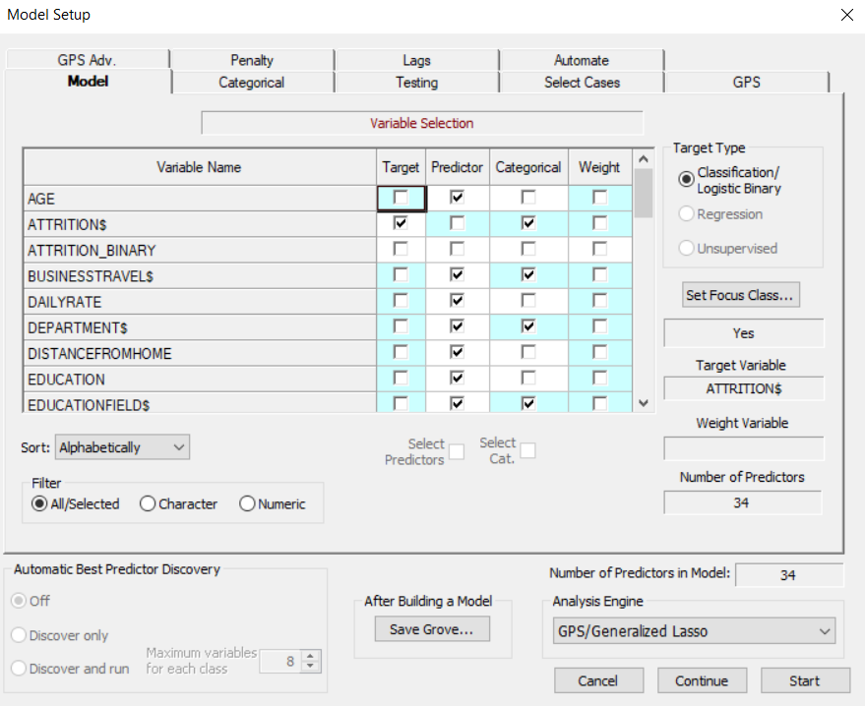

Slide 18
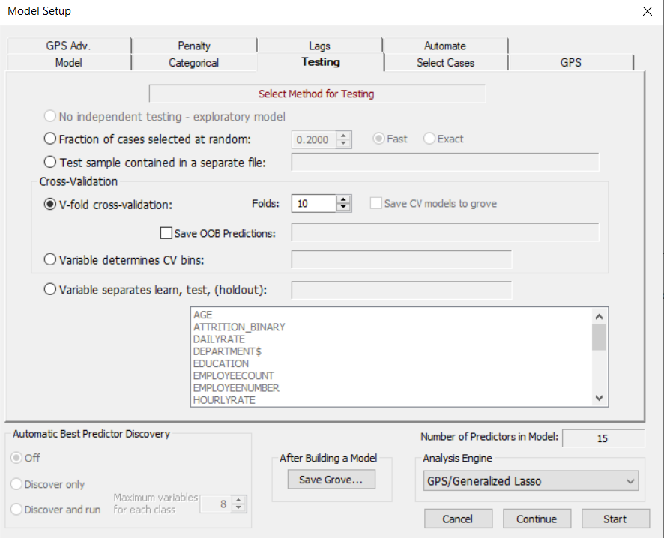

Slide 19
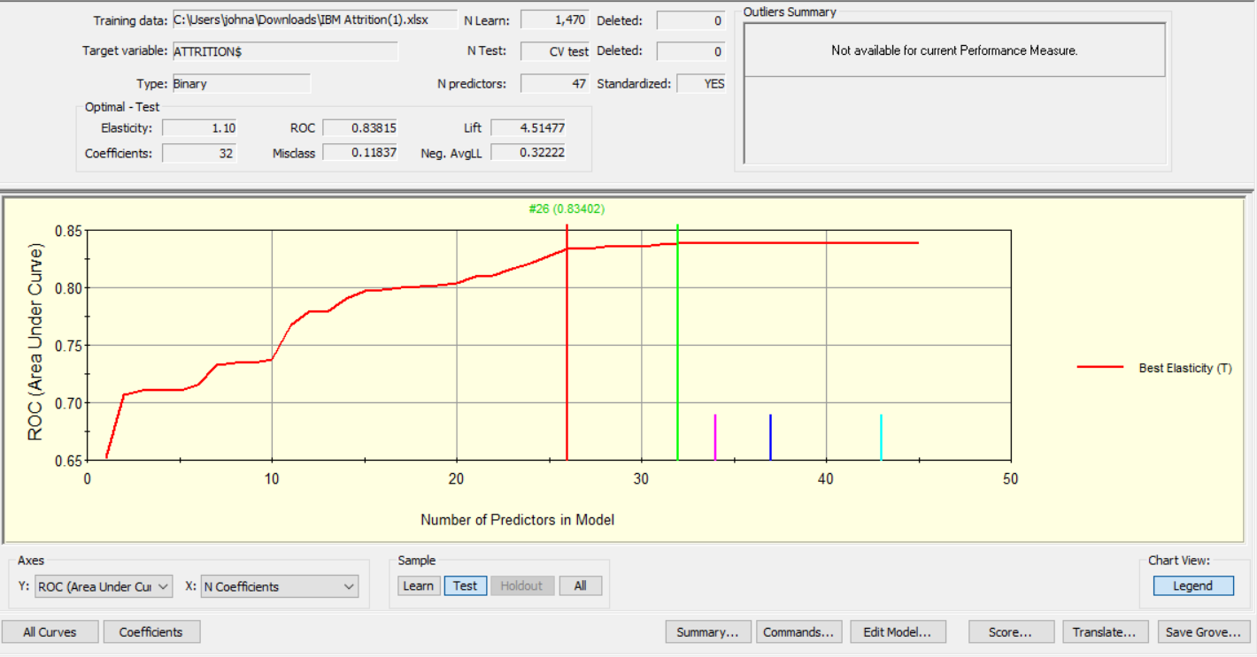
Next We Run as Classification and Perform Prediction

Slide 20
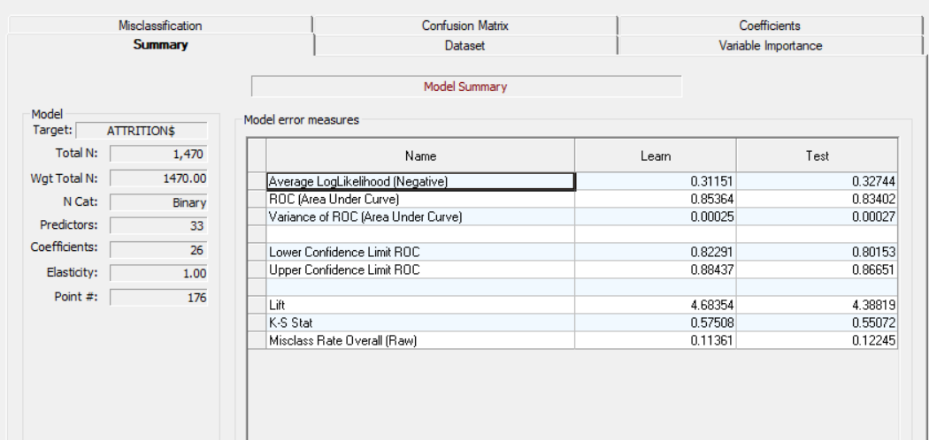

Slide 21
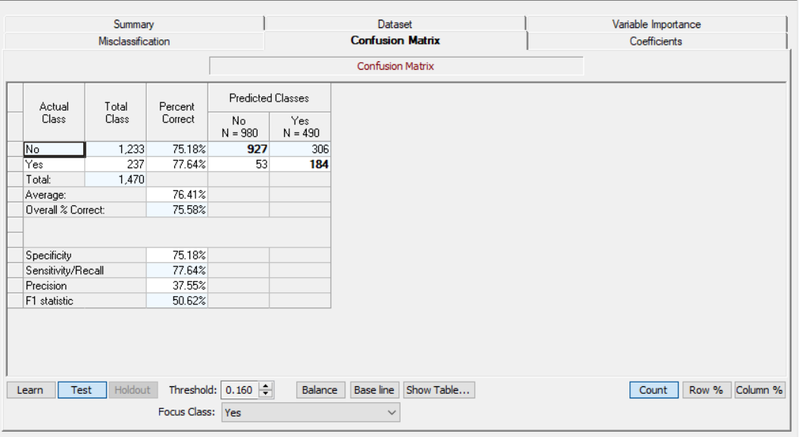

Slide 22
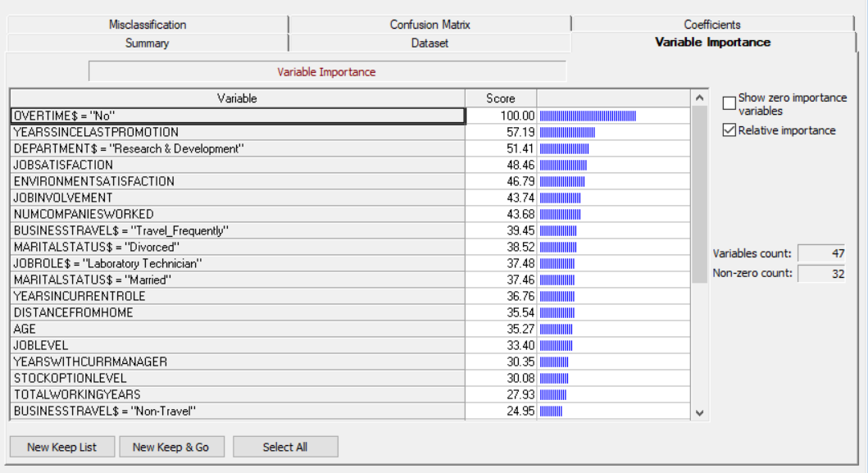

Slide 23
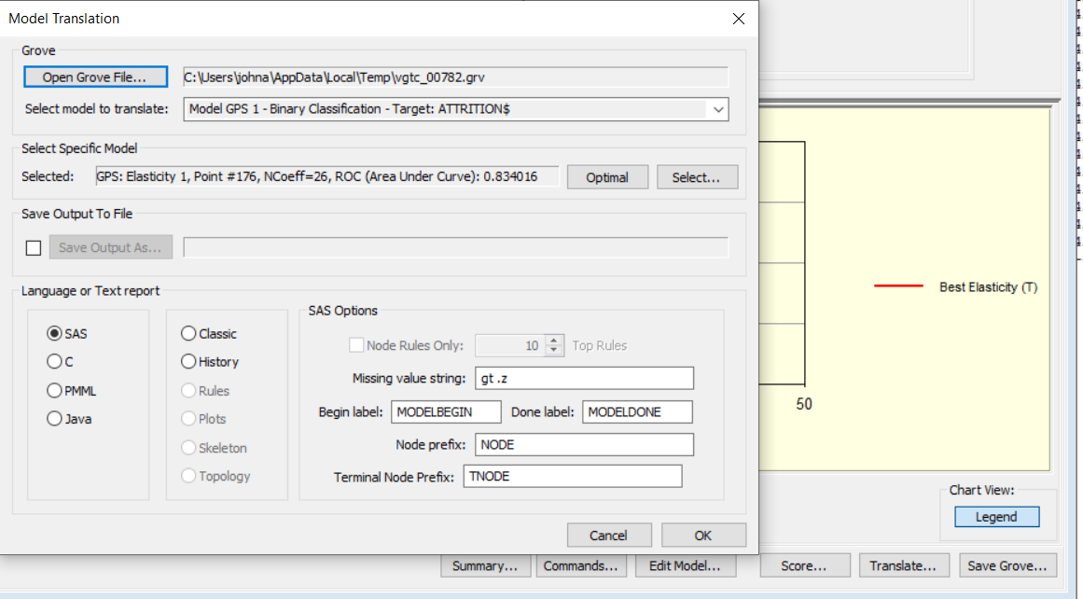

Slide 24
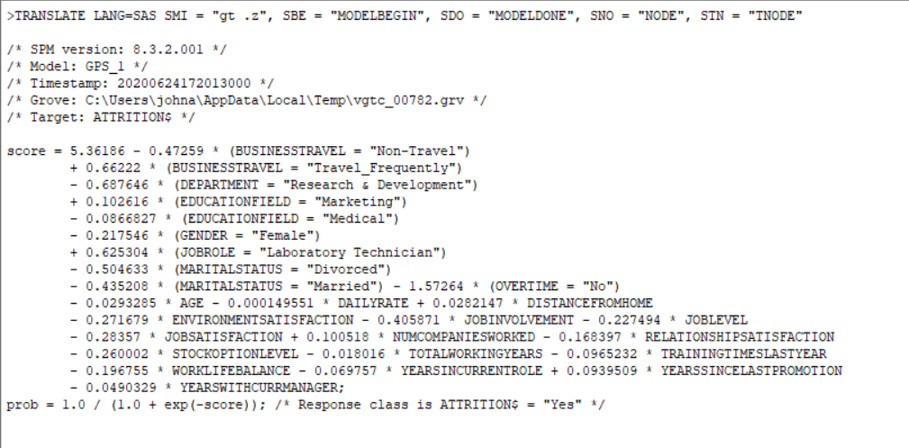

Slide 25
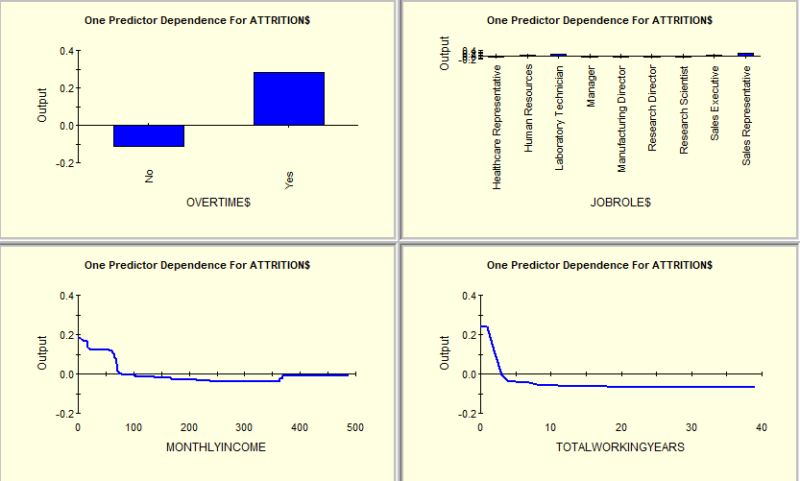
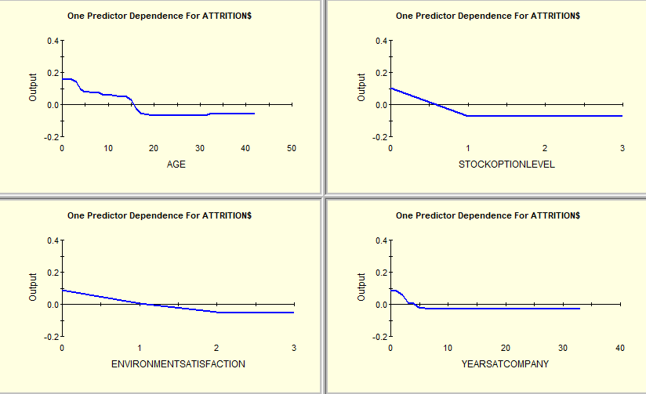
Sales
Entry Level
Predictor Dependence Plots From Treenets Fill In Major Pieces of the Puzzle

Slide 26
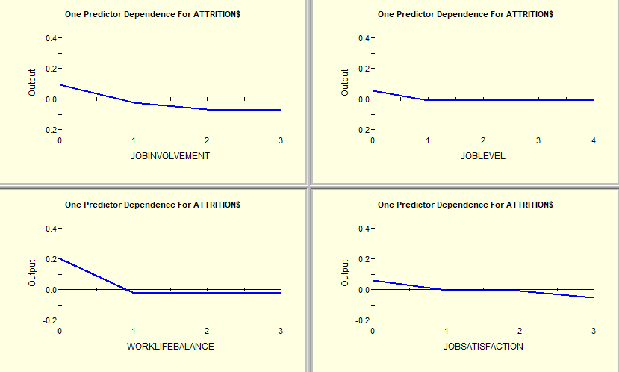
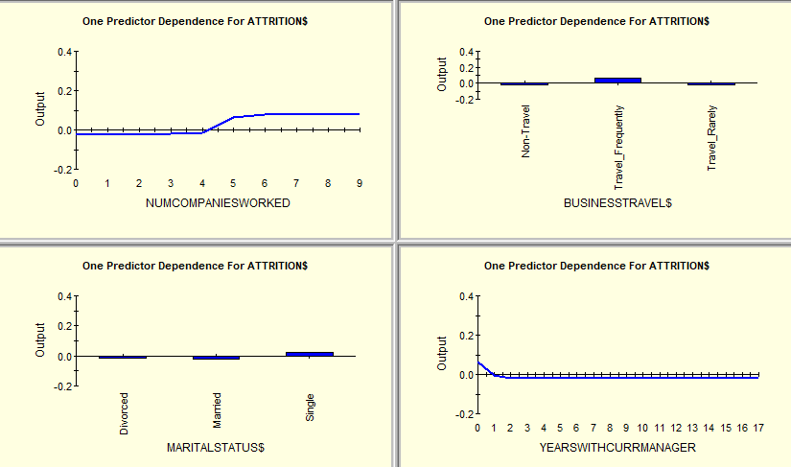

Slide 27
Bullet Points of Consulting Report
Attrition Drivers
Offsetting Strategies (If Desired)
Lab Tech, Marketing
Entry Level
Number of Companies Worked
Frequent Travel
Involvement and Job Satisfaction
Work Life Balance
Other

Slide 28
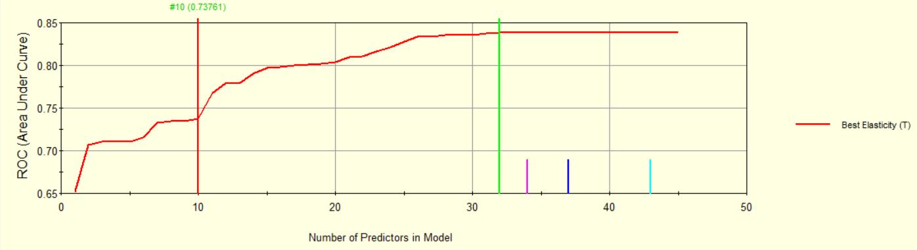
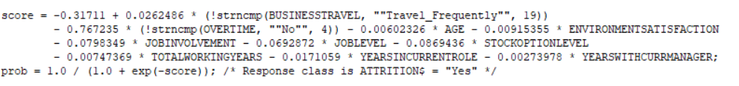
Less Complexity Option
Fewer Data Objects Needed
If you wish to remove “age” from the model, go back and uncheck age and then rerun the model.

Slide 29
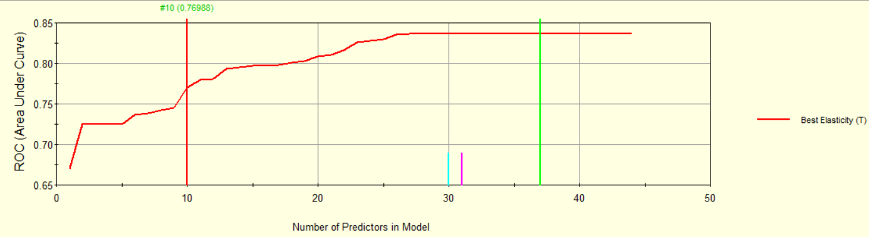
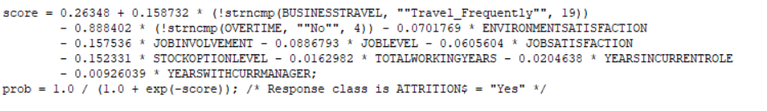
With The Variable “AGE” Removed

Slide 30
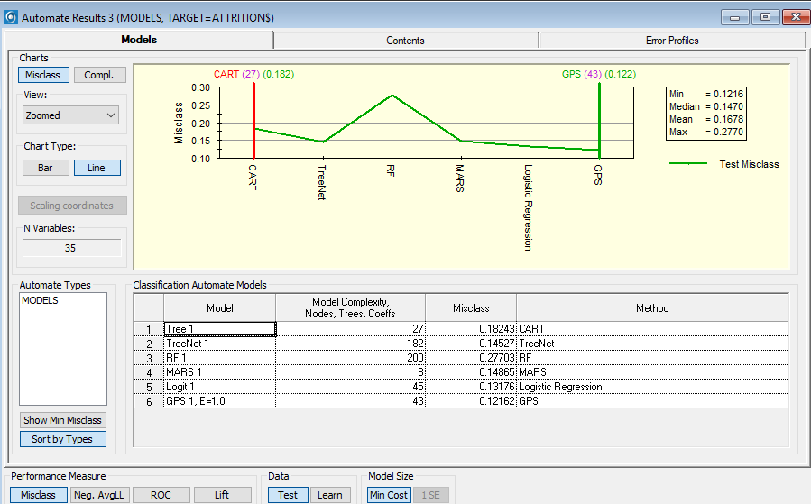
By Using the Automate Function We Can Compare Performance Across Modeling Engines
Misclassification as Criterion

Slide 31
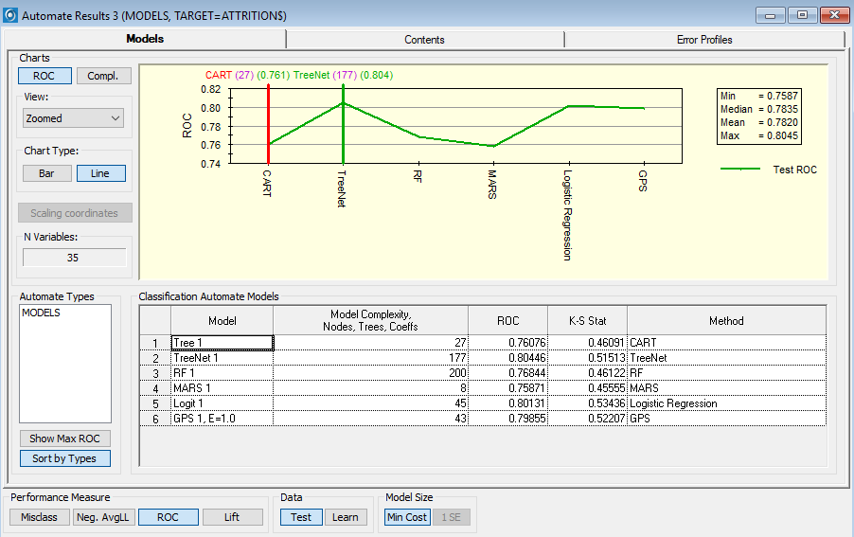
By Using the Automate Function We Can Compare Performance Across Modeling Engines
ROC as Criterion

Slide 32
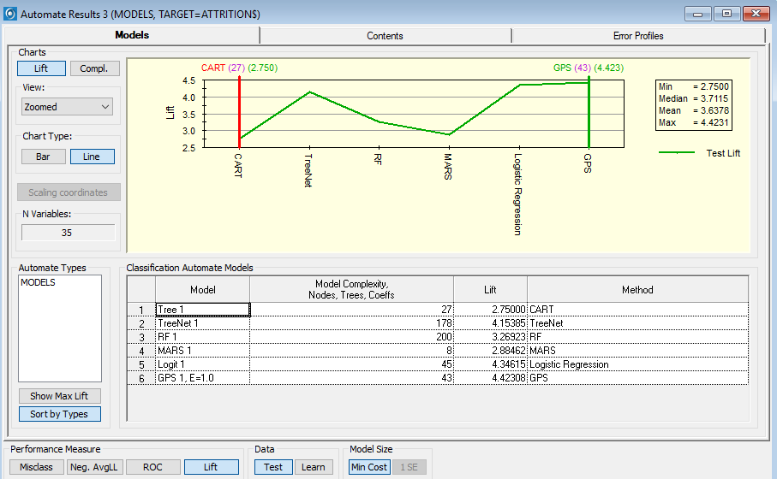
Lift as Criterion

Slide 33
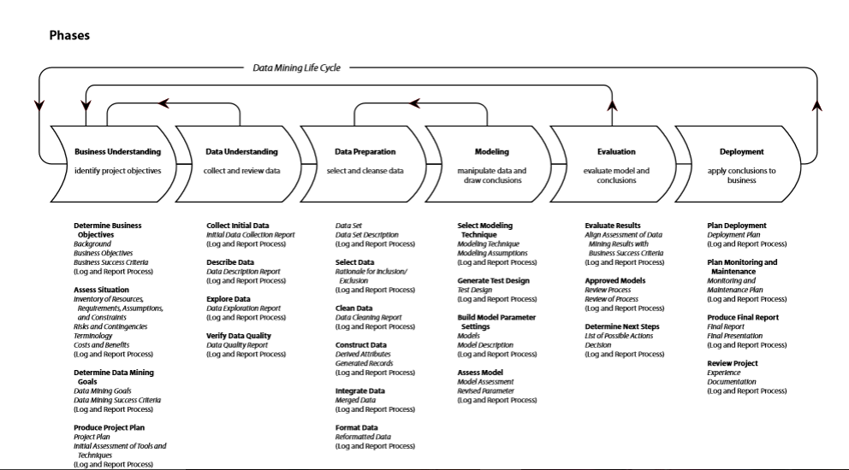
A Revised CRISP-DM Project Methodology with Deliverables to Be Stored in PRIMMS
You should close out open issues, decisions and action items.
Close Out the First Two Phases of PRIMMS.
Model uses GPS or MARS for now, but any available to modeler.
Q-Gate 1
Q-Gate 2
Project Charter, Value Map and Requirements
Baseline Project Schedule
Business Sign-off and Project Authorization. Scope Change Control
First Prototype Completed on Modeler’s Desktop
Weekly Risk Management Survey—VOT Begins
Issues and Gaps Documented
Phase Exit Review Completed
Weekly Status Begins
Consulting Report Issued to Stakeholders
Go Live in PRD
Stabilization
System monitoring
Model Updates
Value Monitoring and
Management
Community Social Media Continues
Second Prototype Completed and Workbooks Deployed
Future State Process Developed with ETL Data Modeled
Future State Process Documented
Schedule Updated
Issues and Defects Captured and Closed
Phase Exit Review Completed
Weekly VOT Continues
Weekly Status Continues
Community Social Media Continues
Third Prototype Created
Test Scripts Created
and Executed in QA
User Acceptance Testing
Completed
Training Scripts Created
User Training Delivered
Issues and Defects Closed
Community Social Media
Continues

Slide 34
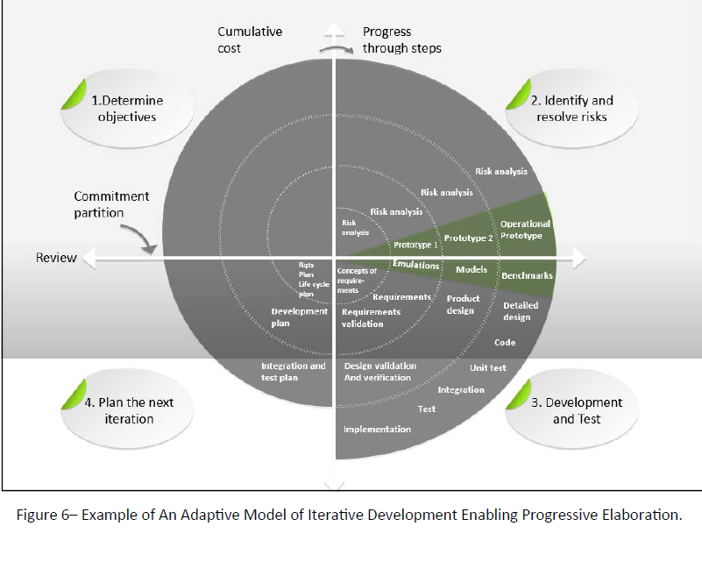
The
Spiral Iterative Development Methodology
Using Various Modeling Engines Can Provide Different Insights of “Explainable Knowledge”

Slide 35
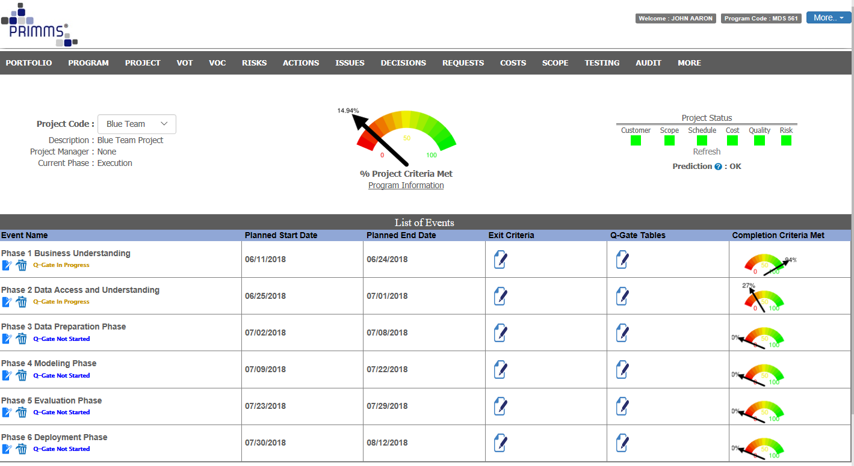

Slide 36
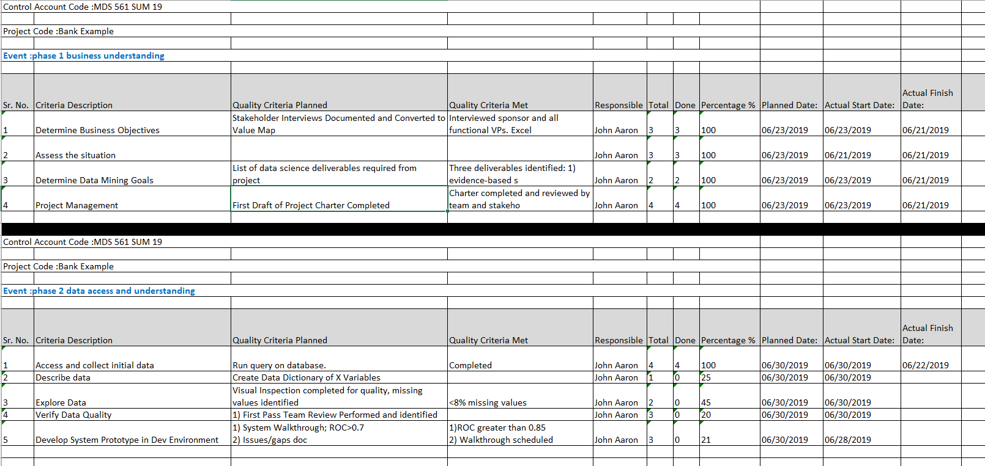
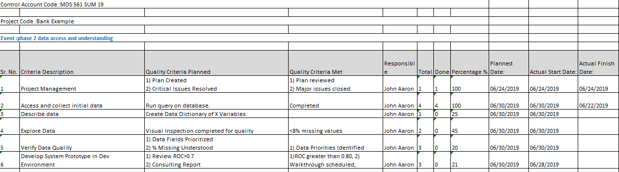
Table to Support Quality Gate #1 Review As Part of Phase 2 Exit. Both completion criteria and quality criteria need to be met for Milestone Attainment. Phase 2 Should Be Nearing Completion. But Not All Deliverables Have Been Discussed

Slide 37
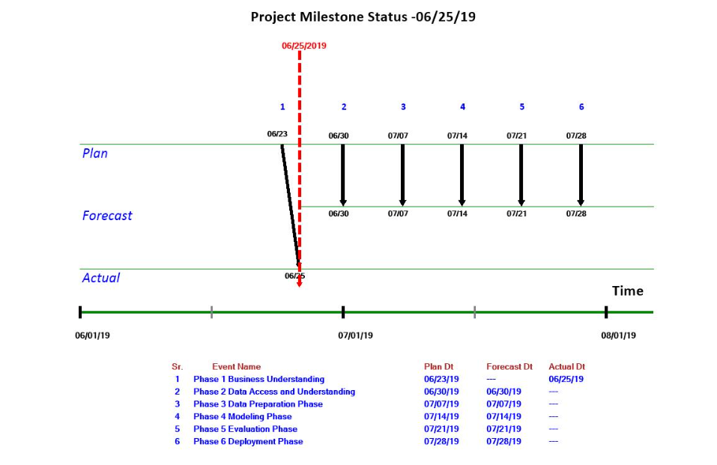
The Slip Chart Conveys Critical Status Information When Anchored in Quality and Completion Criteria

Slide 38
By adopting the Agile Approach we can iterate the cycle multiple times to:
Provide immediate value
Obtain early feedback from the business, enabling adjustments
Provide progressively better and more impactful deliverables
Can terminate project when no longer justified to continue, or We Can Reset Expectations Using Change Control.

Slide 39
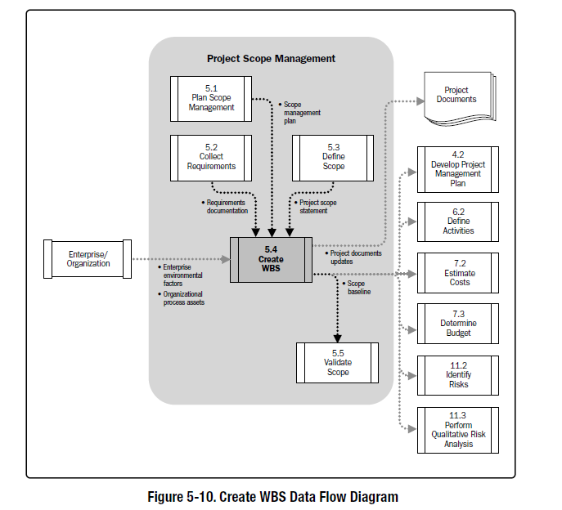
Product Analysis
A procedure for defining and controlling
Relates to what gets handed over to customer.
Describes technical and non technical needs that must be satisfied to meet stakeholders’ project objectives.

Slide 40
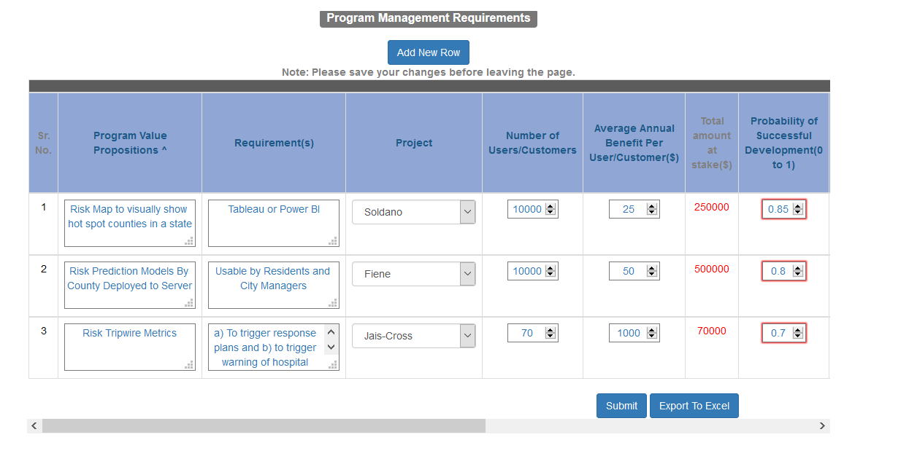
Requirements Have Been Identified But Is the Scope Achievable Given the Time Allowed? How Can Prioritization Help?
Scope Items

Slide 41
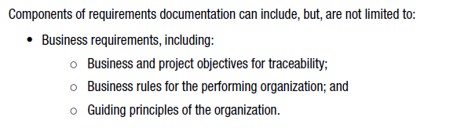
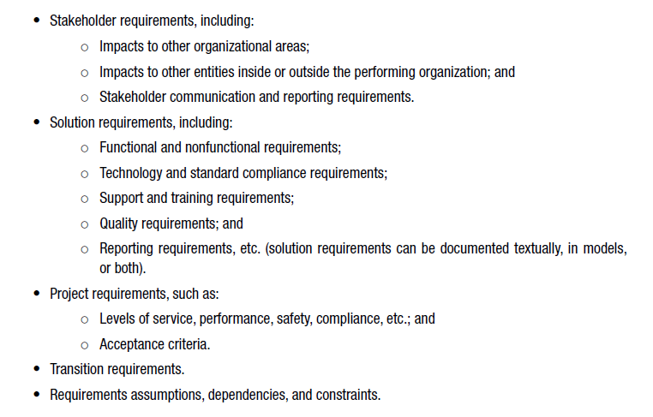
Requirements
Our Emphasis
Added Training and Documentation

Slide 42
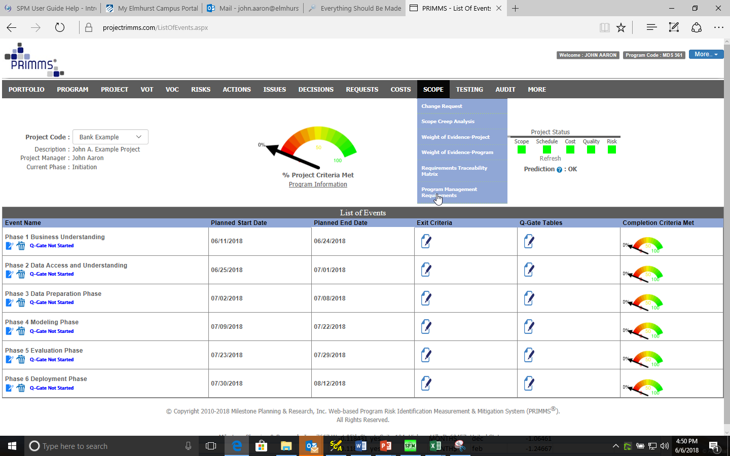
Scope and Requirements
PRIMMS

Slide 43
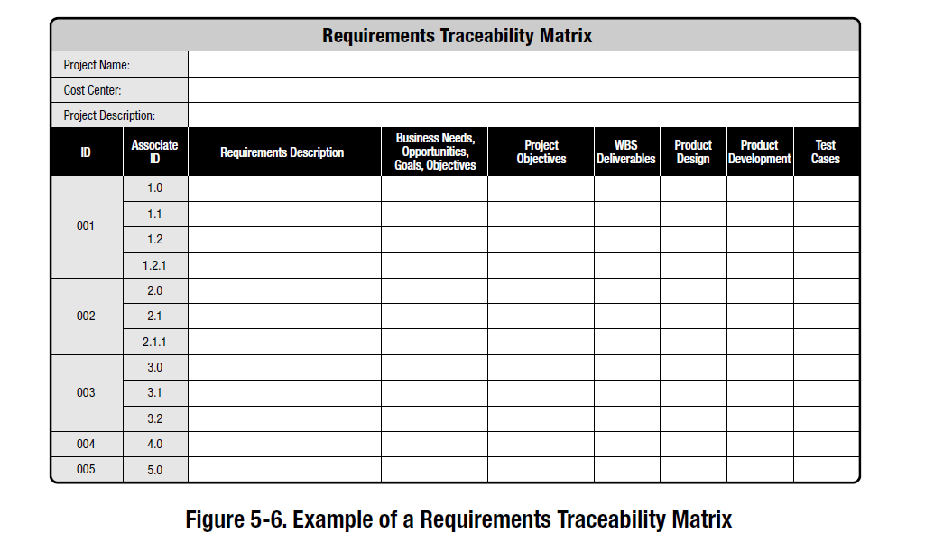

Slide 44
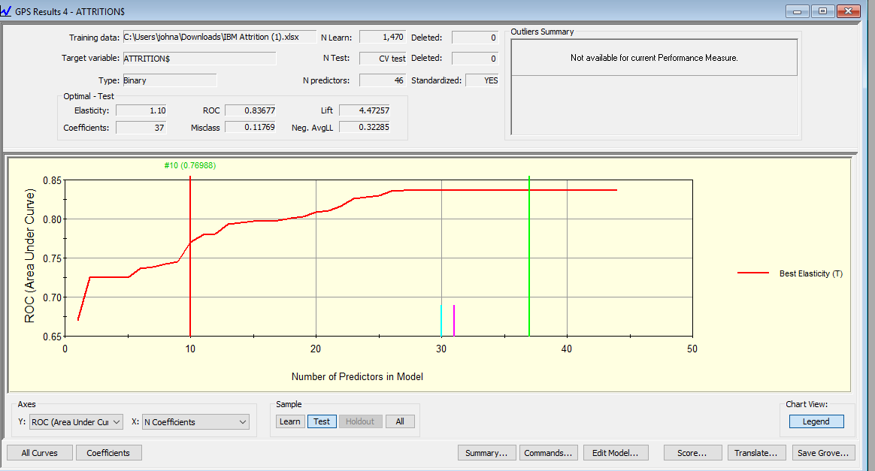
We Begin to Think About Deployment Options
We Score the Model
Will All of the Data Be Available For Future Scoring?

Slide 45
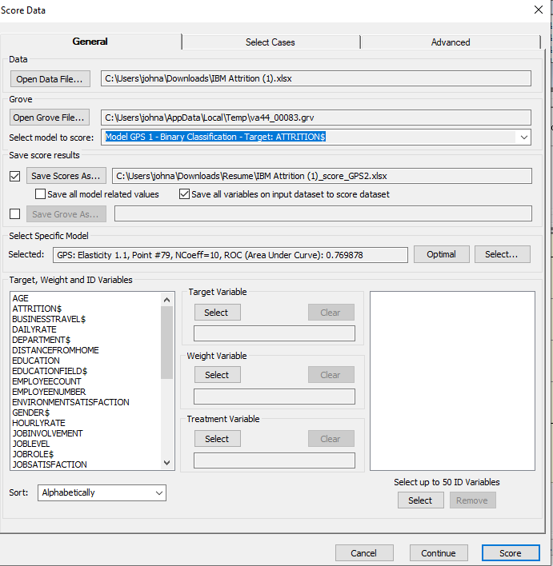
X Variables with or without labels
Saving the output
Starts Scoring

Slide 46
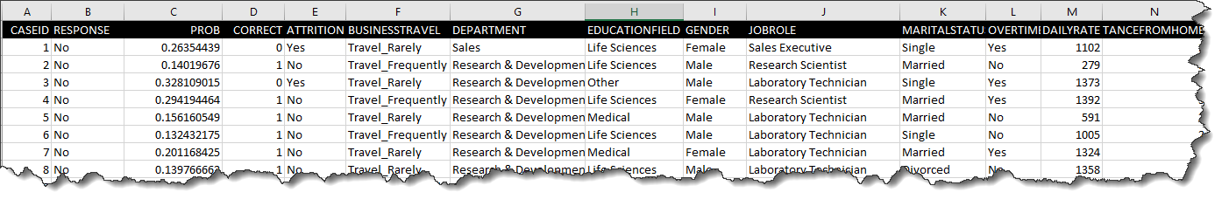
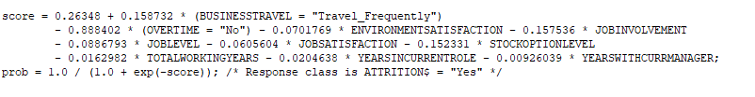
Output File from the Scoring Enables Us to Validate Scoring
SAS Output from Translate
Let’s Walk Through Case Number 1,
how does it compute the probability of 0.26354439?
How does it compute the response “No”

Slide 47
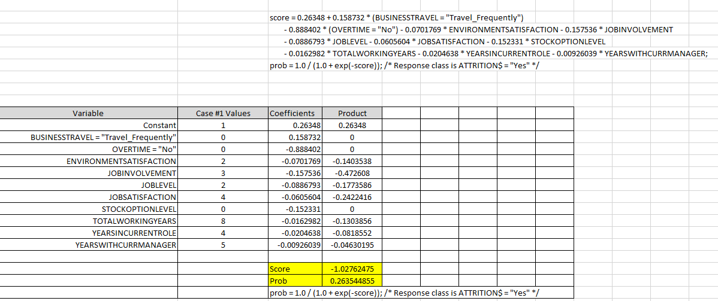

If categorical variables are true, then values go to 1.
Validating GPS Scoring of Attrition Dataset
Threshold is 0.5, so response is “No”

Slide 48

The Complexity of Your Model May Be Tied to Data Availability
Browse the Framework of the Data Governance Institute
www.datagovernance.com
Data is becoming a resource for competitive advantage.
Data Prep is typically the “long pole in the tent”

Slide 49

Suggestions Regarding Data Prep
Cleaning and Harmonizing Data Can Be Major Factors
Take a look at the scope of Tableau Prep https://www.tableau.com/products/prep
Also, Minitab, and Rapidminer TurboPrep

Slide 50


Slide 51


Slide 52


Slide 53


Slide 54


Slide 55


Setting Up the MARS Model

Slide 56


Results of the MARS Model

Slide 57


Results of the MARS Model

Slide 58


Results of the MARS Model

Slide 59

Spline Plots from the MARS Model

Slide 60

MARS Models Are Also Linear. Deployment Requires A Two-Step Process of Probability and Response Prediction
Step 1 Calculate Basis Functions
Step 2 Calculate Probability and Response

Slide 61

Let’s Walk Through Case Number 1 again, this time using MARS
how does it compute the probability of 0.21183887?
How does it compute the response Class “No”

Slide 62

Validating MARS Scoring of Attrition Dataset

Slide 63

Using Excel VBA to Deploy Logistic Regression Model For Scoring
--Attrition Example
Source Code (Similar for Tableau and Power BI)
Threshold set to 0.16 given an unbalanced dataset

Slide 64

Files For Reference
Next Week’s Focus

Slide 65

It Is Common for Technical Project Managers to Focus on The Technology and Forget About Adoption and Acceptance
Organizational Change Projects Are Particularly Challenging Because the Project Manager Must Successfully Handle:
Technology Implementation
Business Process Change
User Understanding and Acceptance of Change
Stakeholder Expectations
Special Public Sector Considerations

Slide 66

We Have Been Presented With Compelling Evidence As To Why An Emergency Situation Was Declared For Certain Geographical Regions
Example: New Jersey

Slide 67


But The Problem Does Not Effect All Geographical Regions Equally
Some States Caught Up In the Principle of Insufficient Reason and Treated All Regions Uniformly—not an optimal policy
https://nj.gov/health/chs/documents/2015-2020%20Deaths%20by%20Month%20and%20County%20of%20Residence.pdf

Slide 68
Need for Hypothesis Testing and Tripwire Metrics at the Local Level
Devastating Impact from Virus and Economic Decline
Strategy Requires Us to Prevent Future Disruption https://info.minitab.com/resources/videos/webinars-on-demand/elmhurst-college-reopening
Plus Some Concern About Policy Guidance From CDC:
Swiss Research Report https://swprs.org/a-swiss-doctor-on-covid-19/
Ferguson and Imperial College Model
https://www.nationalreview.com/corner/professor-lockdown-modeler-resigns-in-disgrace/
https://www.armstrongeconomics.com/world-news/corruption/i-have-reviewed-fergusons-code/
Where is science in all of this?
Go Back to Basics
Peirce
Popper

Slide 69

Nantucket Massachusetts Example
Another source shows 1 COVID death
Must also consider availability of only 11 hospital beds

Slide 70

Scenario If An Actual Crisis

Slide 71


Slide 72

Scenario of What is Likely Happening

Slide 73

But Policy Makers Must Also Consider Limited Hospital Bed Space

Slide 74

Evidence
Evidence
Likelihood Ratio:
0.025/0.160=0.156
10Log₁₀ Odds= -8.00
_{db= -8.00}
No Crisis Hypothesis
P(E|H₀)
Crisis Hypothesis
P(E|H₁)
https://1drv.ms/u/s!AsKbGD6G_CsKojwPruKR-TBrRlwz?e=4HeNF6

Slide 75


Threshold Selection from E.T. Jaynes

Slide 76

From: Jennifer Atlas at Minitab

Slide 77

From: Jennifer Atlas at Minitab

Slide 78

Note: This Assignment is Due July 6th

Slide 79
Appendix

Slide 80

For Wisconsin Data The 2018 Death Rate Per 100,000 Correlates With Many Factors

Slide 81

Note: Latitude and Longitude

Slide 82


Slide 83
Weighing of Evidence and Bayes Theorem: Hypothesis Testing With Minimal Samples

Slide 84


Slide 85


Enigma
Tunny

Slide 86


Slide 87



Slide 88





The Challenge: How to Break the Ciphers Within 24 Hour Cycles
Alan Turing
Gordon Welchman
The “Enigma” Machine
And many other men and women….
Tommy Flowers
I.J. Good

Slide 89

First Part Interview with I.J. Good
https://www.youtube.com/watch?v=6p3mhkNgRXs

Slide 90

The Same Bayes’ Theorem We Used for Naïve Bayes Helped Them Break the Codes
And This Weight of Evidence Approach Will Be Used To Trigger City Response Plans
Likelihood
Add Log Likelihood Ratios
H=True
Count of interest
H=False
Count of interest
Transmission 1
Transmission 2

Slide 91

Weighing of Evidence (Alan Turing and I.J. Good-1940-1950)

Slide 92



Slide 93


Slide 94


Slide 95

Example Adapted by ET Jaynes 1958

Slide 96

Your Instructor Put These Ideas To Work in PRIMMS

